Slide 1
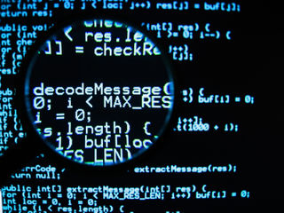
CyberCrime
CSE 301
Louis Wilson Taylor Wood Peter Vascones
Josh Wendt Chloe Wallace Andrew Williamson
Austin Wehn Robin Yau Jeremy Whitaker

Slide 2
CyberCrime
Any type of crime that involves a computer and/or network
One of the fastest growing areas of crime
Speed
Convenience
Anonymity
In the Past
Individuals or small groups
Today
Emerging trend in organized crime
Criminal collaboration
Technology professional pooling their resources and expertise

Slide 3
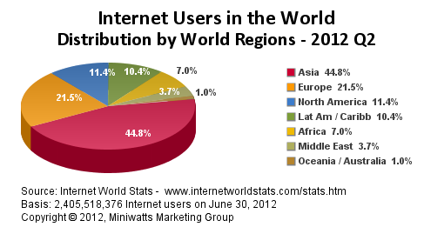
CyberCrime
ORGANIZATIONS
FBI
IC₃
CIA
US Secret Service
INTERPOL
Other Local, State and Federal agencies
Federal Trade Commission, USPS, etc.
Notes:
Internet Crime Complaint Center

Slide 4

CyberCrime
Phishing
Money Mules
Corporate Espionage
ID Theft
The Patriot Act
Online Gambling

Slide 5
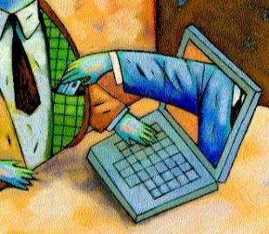
Phishing Taylor Wood
"a scam by which an e-mail user is duped into revealing personal or confidential information which the scammer can use illicitly" - Merriam-Webster
Microsoft "Phone Phishers"
  Call customer acting as a Microsoft technician
  Gain the trust of the victim and eventually get them to give away usernames and passwords
  Walk the victim step-by-step on how to disable their firewall and disable any kind of security program
  Once this is done, the phisher gets the user to install malicious software to allow the phisher access to their computer.
How to avoid this kind of phishing
  If anyone calls you asking for information they are probably a phisher

Slide 6
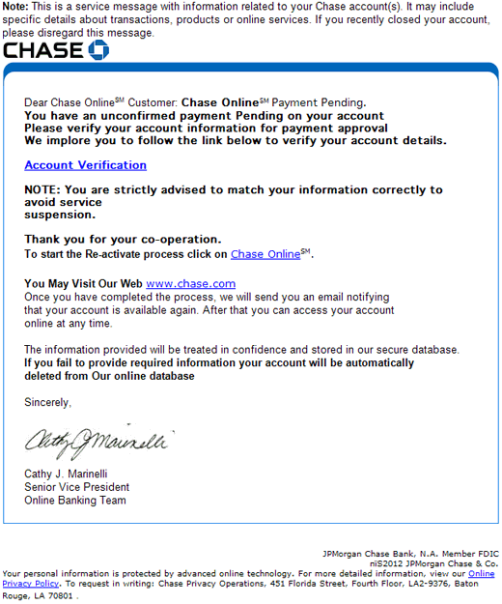
Phishing
Email Phishing
Fortunately, spam filters catch most phishers.
How to avoid:
  just with phone phishers, if they contact you its probably a scam.

Slide 7
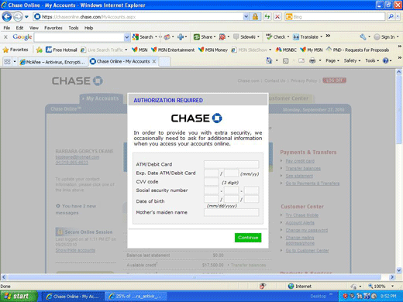
Phishing

Slide 8
Ways to Prevent Phishing
Guard Against Spam
Communicate information only through a phone (if you call them) and a secure website
Do not click on links or download any files that are sent to you
  phishers create websites that look and mimic the real site
Even if they are family or friends, never email personal or financial information
Check your online bank account often to make sure no activity that you didn't approve of is going on.

Slide 9
Types: Spear Phishing
More Targeted
Specific organization or group
Corporate espionage
  Whaling

Slide 10
Types: Tabnabbing
"Reverse" of regular Phishing
Exploits tabbed browsing
  Accustomed to having background tabs
  Change existing tab to phishing site

Slide 11
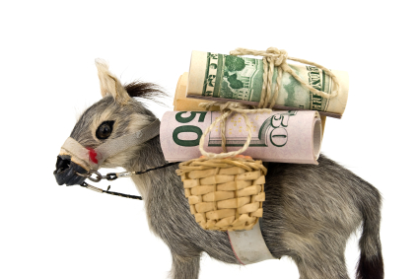
Chloë Wallace
Money Mule:
Someone who transfers stolen money or goods between countries
- Macmillan Dictionary

Slide 12
Recruiting Money Mules
Organizations committing bank fraud or laundering money need to transfer funds internationally
Pose as financial or tax companies
Recruit "mules" through emails offering jobs as "financial agents"
May even have believable interview processes

Slide 13
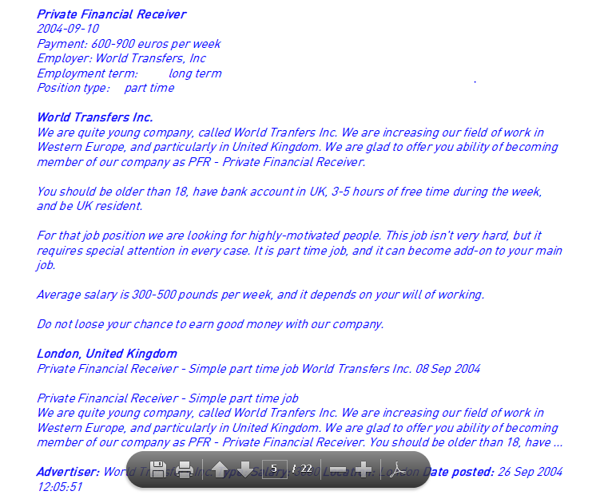
Suspicious Job Advertisements

Slide 14
The Job of a Money Mule
Most people who take the job are either swindled or unemployed and desperate for work
Mules receive checks or transfers from the employer that they send overseas
Most money mules only assist with a single transaction before they are fired
Employer may even spy on their mules

Slide 15
What is the damage?
Australia, 2005:
  60 people arrested with earnings of >$600,000
  Mostly teenagers
  Money was stolen from victims of a keylogger Trojan that recorded bank information
  Millions of dollars stolen and transferred to Malay and Russia
  Some teenagers were prosecuted for involvement

Slide 16
Ethical Considerations
Is it ethical to accept a job as a money mule?
Should people who unwittingly worked as money mules be legally liable?

Slide 17
Corporate Espionage
What is Corporate Espionage?
  Espionage conducted for commercial purposes and not for "National Security"
  Can be as simple as a guy sitting in a basement, or as elaborate as having employees hired at competing companies to report on projects.
  Includes Low Tech and High Tech solutions such as digging through garbage to hacking major corporate networks.

Slide 18
Corporate Espionage
How often does it happen?
  At it's simplest form it is conducted nearly every second of every day, as companies are continually gathering information about competitors.
  Major breaches are thought to be reported as little as possible. Companies are reluctant to disclose breaches in their security due to attracting others, being perceived as weak, or having their stock price drop.
  There also is a question of when would be an appropriate level of breach to report a violation. Many companies fend off attacks on their networks many times per day. Most are unsuccessful, or only moderately successful and are stopped before any secure information can be reached.

Slide 19
Corporate Espionage
Where should the line be drawn?
  Is there really a difference in researching your competitors with publicly available information and espionage?
    Digging through garbages in public places?
    "fine tooth combing" website, social media, etc.
    Gathering third party references (i.e. Golf rosters, memberships)
  Many parts of a story can be put together using small pieces of information. Is the sum of legal and moral practices become immoral when they are used to put together a "whole picture" to gain from it.

Slide 20
Corporate Espionage - Notable Instances
1987-1989 - France spies on IBM and Texas Instruments to help the state owned Groupe Bull
1993 - German car company Opel accuses Volkswagen
  Volkswagen subsequently sues for defamation
  Ends with Volkswagen paying Opel $100 million
2010 - Operation Aurora - GoogleChina and 20 other companies across China hacked
  One motive was to collect personal information on human rights activists
Notes:
priority list obtained by CIA sholist obtained by CIA showing intentions of stealing specific technological information from various aeronautical companies.
wing intentions of stealing specific technological information from various aeronautical companies.priority list obtained by CIA showing intentions of stealing specific technological information from various aeronautical companies.

Slide 21
Impacts of Corporate Espionage
Decreased profits for ethical companies
Strained relationships amongst corporations
Strained diplomacy amongst nations
Potentially decreases innovation due to emphasis on copying over creating

Slide 22
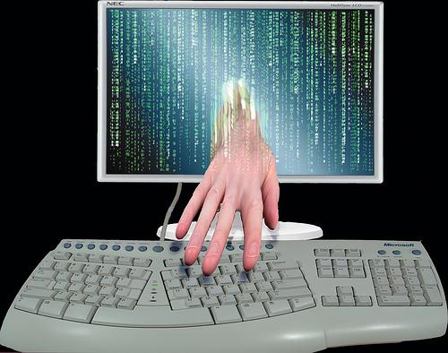
ID Theft - Beginning Information
What is identity theft?
The FTC explains that identity theft occurs when someone uses your personally identifying information, like your name, Social Security number, or credit card number, without your permission to commit fraud or other crimes.
How many people have their identities stolen?
The FTC estimates that as many as 9 million Americans have their identities stolen each year. So many, in fact, that you may know someone who have experienced some form of identity theft.
Speaker: Andrew Williamson

Slide 23
ID Theft - Techniques
How does somebody steal an identity online? What should I watch out for?
1. Phishing: They pretend to be something they are not in an attempt to get your personal information.
2. IP Spoofing: A technique used to gain access to computers, whereby the intruder sends a message to the computer with an IP address indicating that the message is coming from a trusted source.
3. E-Mail Spoofing: The header of an e-mail appear to have originated from a trusted source in an attempt to get you to respond to their solicitations.
4. Link Alteration: Altering the return address in a web page sent to a consumer to make it go to the hackers site rather than the legitimate site. This happens mostly from E-Mail Spoofing.

Slide 24
ID Theft
What do they do with my identity?
1. Credit card fraud - They may open credit card accounts in your name, and max them out. Leaving you with the problems on your credit report.
2. Phone or utilities fraud - They may open up a new phone or wireless account in your name, and run up the charges. They can even run up charges on an existing account that you own.
3. Bank/finance fraud - They can create counterfeit checks, bank accounts, ATM/debit cards and loans in your name.
4. Government documents fraud - They may get a drivers license or official ID card issues in your name but with their picture.
They can even get a job, rent a house to someone and tell a police officer that they are you while being arrested.

Slide 25
ID Theft
How to keep safe?
Everyone here is technologically adept. Use common sense and check URLS when nervous about a page. When getting a fraudulent email, check it thoroughly. Don't make purchases on any places that seem a bit off. NEVER GIVE OUT YOUR SOCIAL SECURITY NUMBER. This website is also a great source for information: http://www.onguardonline.gov/articles/0005-identity-theft
What are the ethics?
This is a relatively new problem but our legal system and news media have sent a message out about identity theft: it is criminal. There is no excuse. Everybody that commits ID theft knows that it is a crime and it is blatant. The ethics are obvious but i'll put it here just in case something is unclear:
Don't steal somebody's ID. You will ruin your life if you try, and you deserve to be locked away if you are that dumb to try.

Slide 26
The Patriot Act
Title I: Enhancing Domestic Security against Terrorism
Title II: Surveillance procedures
Title III: Anti-money-laundering to prevent terrorism
Title IV: Border security
Title V: Removing obstacles to investigating terrorism
Title VI: Victims and families of victims of terrorism
Title VII: Increased information sharing for critical infrastructure protection
Title VIII: Terrorism criminal law
Title IX: Improved Intelligence
Title X: Miscellaneous

Slide 27
Title II: Surveillance procedures
Allowed government to gather intelligence on U.S. and non-U.S. citizens and share it.
Expanded the scope of wiretapping to include session times, durations of communication, and numbers / addresses.
Allowed to wiretap on normal search warrant.
Roving wiretap.
Gave FBI access to documents to reveal patterns of U.S. citizens.
Allowed law enforcement to physically enter onto private property without owner's permission or knowledge. Fortunately, it was considered unconstitutional afterwards and repealed.

Slide 28
Controversies
Citizens giving up privacy and some constitutional rights for "protection"?
U.S. vs. Antoine Jones
Nightclub owner linked to drug trafficking
Had a GPS unit attached to his car without a warrant

Slide 29

Online Gambling
A quick description and the surrounding ethical issues.
By Jeremy Whitaker

Slide 30
Description
Online Gambling is basically what it sounds like: any gambling or betting of money that occurs over the internet.
There are many forms of Online Gambling: Poker, Online Casinos, Sports Betting, Online Bingo, Online Lotteries, etc.
Different forms of Online Gambling can carry different legal restrictions.

Slide 31
History
In early 1990's, Isle of Man-based software company developed the first functional gambling software.
Using secure money transaction software created by CryptoLogic, the first online casinos became available in 1994.
Online gained much of its popularity in late 1990's, and revenue produced by online gambling continued to climb - more than $830 in 1998 alone.

Slide 32
Legal Controversies
In the United States, there has been a lot of disagreement over the legality of Online Gambling due to differences in court rulings as well as unclear specifications defined in the Wire Act.
Other countries also have their own sets of laws regarding Online Gambling which can limit the practice based on geographic location or citizenship - controversial due to nationally limiting an international practice. Eg, Australian law restricts any Online Gambling so long as the user is in Australia.
Limitations and restrictions on Online Gambling can apply to only specific types of gambling. Eg, the United States Wire Act only actually restricts online sports betting and not online casinos, but the federal Department of Justice still holds that online gambling is illegal.
International controversies have risen due to the differences in the legality of Online Gambling among countries.

Slide 33
Ethical Issues
Many people treat gambling as a hobby, and they just see the internet as a means to enjoy that hobby more readily, but in many cases it's restricted due to moral inclinations. Should morality weigh into restricting Online Gambling?
Some companies such as Google and Yahoo have been pressured into removing Online Gambling advertising due to the opinion of the United States Department of Justice. Should companies have to make decisions based on federal opinion?
There's no absolute way to regulate the age of the user of an online gambling site. Although gambling is largely agreed to be an adult activity, children are able to participate through means of Online Gambling. What needs to be done to ensure that children don't use an online gambling site?

Slide 34
Conclusion
CyberCrime
Fast growth and increased collaboration
Phishing
Is awareness enough?
Money Mules
Should people who unwittingly worked as money mules be legally liable?
Corporate Espionage
Research vs Espionage (where is the line?)
ID Theft Credit card fraud, utilities fraud, bank fraud.
The Patriot Act
Is your privacy worth your “protection"?
Online Gambling
A hobby?
How do you validate Age online?

Slide 35
Thank you!

Slide 36
Sources
http://www.connectamarillo.com/news/story.aspx?id=769794#.ULfjbIZ1uPU
http://epic.org/privacy/terrorism/usapatriot/
Money Mules:
http://www.ftc.gov/bcp/edu/microsites/idtheft/consumers/about-identity-theft.html
http://krebsonsecurity.com/2010/05/fbi-promises-action-against-money-mules/
http://www.theregister.co.uk/2005/01/06/phisherman_fagins/
http://pages.cs.wisc.edu/~rist/642-fall-2012/iDefense_MoneyMules_20060329.pdf
http://krebsonsecurity.com/2012/07/spy-software-aims-to-corral-money-mules/
Corporate Espionage:
http://www.hanford.gov/files.cfm/frenchesp.pdf
http://articles.latimes.com/1996-05-12/news/mn-3419_1_volkswagen-sues-gm
http://googleblog.blogspot.com/2010/01/new-approach-to-china.html
Online Gambling:
http://www.uri.edu/personal/awel5922/gambling.index.html
http://en.wikipedia.org/wiki/Online_gambling
http://www.free-internet-gambling.com/online-gambling-is-a-fair-industry/
http://www.fbi.gov/news/stories/2009/april/spearphishing_040109/
http://searchsecurity.techtarget.com/definition/spear-phishing
http://www.azarask.in/blog/post/a-new-type-of-phishing-attack/

